Slide 1
Public’s Perception of Pharmacy Services during COVID-19 in Saudi Arabia
Yousef Ahmed Alomi, Sultan Mohammed Al-Jarallah,
Dona Abdullah Alajmah, Shatha Alhassan Alnami,

Slide 2
ABSTRACT:
Goal: To exemplify the public’s perception of pharmacy services during COVID-19 in Saudi Arabia. Methods: It is three cross-sectional of convenient sampling and calculated number of the subject with power eighty. It was a self-reported electronic survey for the population in the King of Saudi Arabia. It encompassed all citizens who lived in Saudi with age more than 18 years and above. The survey contained of the demographic data patient’s perception of medication delivery service during COVID-19. Besides, the patient’s experiences of drug information inquiries were linked with the pharmacist during COVID-19. Survey monkey, Microsoft Excel, and Statistical Package of Social Science (SPSS) were used in this study.

Slide 3
ABSTRACT:
Results: The total number of responding pharmacists was 461. Of those, 440 (95.44%) were Saudi, and 344 (74.62%) were female, with statistical significance between nationality or gender answers (p<0.001). Almost two-thirds of the responders had bachelor’s degrees 319 (69.20%) with statistically noteworthy between among all academic qualifications (p<0.001). Most of the responders were non-healthcare professionals 338 (74.45%), and physicians and nurses illustrative high percentages 37 (35.92%) and 31 (30.10%), respectively, with statistically significant among the remaining answers (p<0.001). The total average scores of patient’s perception of medication delivery service during COVID-19 were 2.50. The high scores element was answering drug information inquiries (3.30), medications home delivery (2.80), and requesting medications through a mobile application (2.78). The total average scores of patient’s experiences of drug information inquiries communicated with a pharmacist during COVID-19 were 2.76 with high scores element was the drug administration inquiries (3.37). In addition, dosage/ schedule inquiries (3.29) and Pharmacoeconomics/medications cost inquiries (3.18) were also entailed.

Slide 4
ABSTRACT:
Conclusion: The public’s perception of medication delivery service and experiences of drug information inquiries transferred with the pharmacist during COVID-19 was not optimum. Therefore, targeting a strategic plan of hospital and community pharmacy services during pandemic situations is highly suggested. In addition, further studies of hospital and community pharmacy services individually during a pandemic or emergency public health are mandatory in Saudi Arabia.

Slide 5
Key Words :
COVID-19,
Community,
Pharmacy.

Slide 6
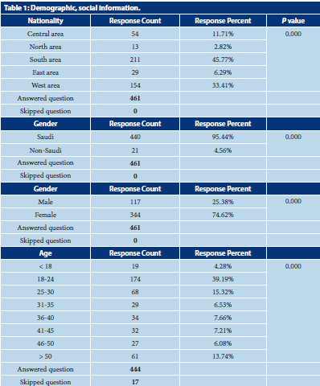

Slide 7
CONCLUSION:
The public’s perception of pharmacy services during COVID-19 in Saudi Arabia highlights the patient’s perception of medication delivery. The patient’s experiences of drug information inquiries communicated with the pharmacist were insufficient. There are no differences in the perception between public or healthcare providers in the perception. Therefore, no factors affect the responders of Patient’s perception of pharmacy services. More pharmacy applications with drug consultation, medication and devices requesting, and home or mail delivery systems are highly suggested during pandemic situations or emergency public health in Saudi Arabia.

