Slide 1
The Practice of Nuclear Pharmacy Services by Pharmacists in Saudi Arabia
Yousef Ahmed Alomi, Ali Taer Al-Asmri, Mohammed Abdulaziz Ayoub Asiri, Abdulaziz Saleh Alnabbah

Slide 2
ABSTRACT:
Goal: In this study, we aimed to illustrate the practice of nuclear pharmacy services in Saudi Arabia. Methods: This is a cross-sectional study. An electronic survey was distributed to all pharmacists and pharmacy interns. Students were excluded from this study. The survey consisted of demographic data about responders and pharmacy practice aspects of nuclear pharmacy. The data were collected using the Survey Monkey system and analyzed using Microsoft Excel and Statistical Package of Social Science (SPSS).

Slide 3
ABSTRACT:
Results: A total of 235 pharmacists responded to the survey, with most of them coming from the southern region (82 (34.89%)), central region (49 (20.85%)), and western region (47 (20.00%)), with statistically significant differences between the regions (p<0.001). Almost two-thirds of the pharmacists had obtained Bachelor’s degree (149 (63.40%)) and Diploma in Pharmacy (75 (31.91%)), with statistically significant differences between all the pharmaceutical degrees (p<0.001). Most pharmacists were staff pharmacists (119 (51.29%)) and interns (43 (18.53%)). The total average score of elements of the practice of nuclear pharmacy services was 1.69. The highest score was recorded for the element “nuclear pharmacy and facilities, equipment, and place for preparation are available” (1.79), followed by the elements “nuclear pharmacy and drug monitoring system” (1.78) and “nuclear pharmacy and radiation safety” (1.77). The average score for the element “nuclear pharmacy practice implementation” was 3.39. High scores were obtained for the element “nuclear pharmacy should be covered by health insurance” (3.79) and “nuclear pharmacy outsourcing is highly recommended” (3.67). The highest score was obtained for the element “nuclear pharmacy currently is the responsibility was a nuclear pharmacist” (4.28) and “toxicologist laboratory” (3.55). Conclusion: The various aspects of pharmacists based on the elements of the practice implementation of nuclear pharmacy were insufficient in the Kingdom of Saudi Arabia. Pharmacists play an active role in the nuclear pharmacy practice. Further studies on nuclear pharmacy services should be conducted thoroughly and setup strategic plan to improve nuclear pharmacy services in Saudi Arabia.

Slide 4
Key Words :
Practice,
Nuclear,
Pharmacy,
Saudi Arabia.

Slide 5
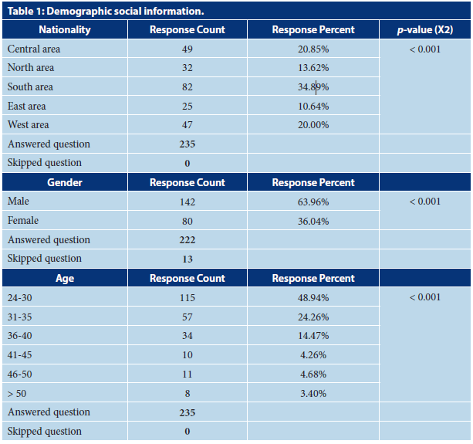

Slide 6
CONCLUSION
The practice of nuclear pharmacy in Saudi Arabia is poor, which could be due to various factors that influenced the implementation of nuclear pharmacy, such as young age. On the other hand, more experience or higher position as the supervisor showed good pharmacists’ knowledge in terms of practice. Therefore, nuclear pharmacists should be increased and involved in nuclear medicine with a clear job description. Further in-depth survey about nuclear pharmacy services is required, and strategic plans should be set up to improve nuclear pharmacy practice in Saudi Arabia.

