Slide 1
Pharmacist Practice of Forensic Pharmacy Services
Yousef Ahmed Alomi, Mawadah mohsen aqeeli, Rehab Sultan Najmi, Samiyah Ibrahim Qassadi

Slide 2
ABSTRACT:
Goal: The current study expected to demonstrate the forensic pharmacy practice in the Kingdom of Saudi Arabia. Methods: It is an analysis of a cross-sectional study. An electronic survey was dispersed to all pharmacists and pharmacy interns. All students were omitted from the existing study. The survey consisted of demographic data about responders and practice aspects and implementations of forensic pharmacy. All analysis was completed using Microsoft Excel and Statistical Package of Social Science (SPSS), and Survey monkey.

Slide 3
ABSTRACT:
Results: The total number of responding pharmacists was 402. Of those, 198 (49.75%) were male, while 200 (50.25%) were female, with statistical significance between them (p<0.001). Almost three-quarters of the pharmacists had bachelor’s degrees 303 (75.56%), with statistically significant among all pharmaceutical degrees (p<0.001). The total average scores of pharmacist feature elements of forensic pharmacy services were 2.5. The high scores element was forensic pharmacy and potential drug-drug interactions (1.42). On the contrary, the lowest score aspect of nuclear pharmacy was forensic pharmacy, education and training program (1.26). The average score of forensic pharmacy practice implementation was 3.15. With high scores was the pharmacist always parts in crimes medicine committee (3.74), while the lowest forensic pharmacy practice implementation scores were attendance several courses or workshops about forensic pharmacy (2.41). Conclusion: The pharmacist part elements or the practice applications of forensic pharmacy were insufficient. The pharmacist plays an active role in the forensic pharmacy practice. Recognized forensic pharmacy with a clear job description of pharmacy staff with the relationship with forensic medicine and forensic strategic planning is mandatory to improve forensic pharmacy services in Saudi Arabia.

Slide 4
Key Words :
Practice,
Pharmacist,
Forensic,
Pharmacy,
Saudi Arabia.

Slide 5
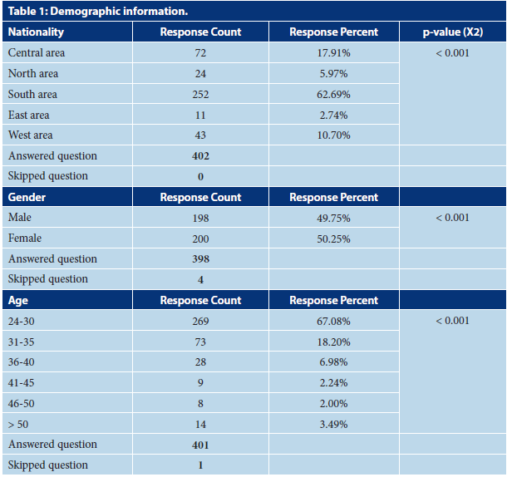

Slide 6
CONCLUSION:
The practice of forensic pharmacy was inadequate. The majority of pharmacists work in forensic pharmacy through potential drugdrug interactions in forensic sciences, forensic pharmacy, medications errors systems, and drug quality reporting systems. No numerous factors predisposed the forensic pharmacy practice except position career number only. The number of forensic pharmacy staff should be augmented and involved in forensic medicine. Further study of forensic medicine and pharmacy services in-depth detail was necessitated to setup up a strategic plan and improve forensic pharmacy practice in Saudi Arabia.

