Slide 1
Accounting and Financial in Pharmacy Practice: Financial Position Statement (Balance Sheet)
Yousef Ahmed Alomi, Ghadeer Zayed Aljumah, Nasser Rashid Alohlie, Naif Saleh Alamri, Riyadh M Alashban, Maha Hussein Almadany, Abeer Hussin Almasoudi, Basmah Suliman AlHamdan, Ghudair Tashan Alanazi

Slide 2
ABSTRACT:
Objectives: To the financial position statement (balance sheet) policy and procedures in pharmacy practice as a new initiative in Saudi Arabia. Methods: It was a narrative review of the Financial position statement (balance sheet) policy and procedures in pharmacy practice. Litterateur searched various databases, including PubMed, Medline, and Google Scholar. The search period is from the 1960s until 15 October 2023. The term is in full-text English and includes Case Reports, Classical Articles, Clinical Conferences, Clinical Studies, Clinical Trials, Evaluation Studies, Government Publications, Guidelines, Meta-Analysis, Observational Studies, Practice Guidelines, Randomized Controlled Trials, Reviews, Systematic Reviews, with Humans subject. All hospital or community pharmacy services are included in a search term. Besides, the National and international guidelines of general infection control in hospital practice. The committee of pharmacy accounting policy and procedures formulated and consisted of various expert members. That includes clinical pharmacists, accountant specialists, and financial experts. The guidelines of the policy draft by one member by the second member were reviewed and corrected. The third revision was by the accountant specialist. The topic emphasizes the Financial position statement of the Pharmacy policy.

Slide 3
ABSTRACT:
Results: the financial position statement in pharmacy practice indicates its financial position at a particular time, indicating its assets, liabilities, and equity. The financial position statement showed the relationship between these three elements of the pharmacy’s total assets, liabilities, and equity and how these items have changed over time. As illustrated in the review, various analyses are required for the financial position statement, including general analytics, profitability, liquidity, liabilities, efficiency, and price or market analysis or investment analysis policy and procedures. Conclusion: The financial position statement in pharmacy practice policy and procedures is a new initiative project for non-professional accountants. The financial position statement in pharmacy practice improves business and financial decisions. In addition, it encourages pharmacists to adhere to accounting and financial regulations at various places at healthcare institutions. Therefore, the financial position statement in pharmacy practice policy and procedures policy is highly recommended for implementation in the pharmacy business in Saudi Arabia.

Slide 4
Key Words :
Accounting,
Financial,
Policy,
Pharmacy,
Financial Position,
Saudi Arabia.

Slide 5
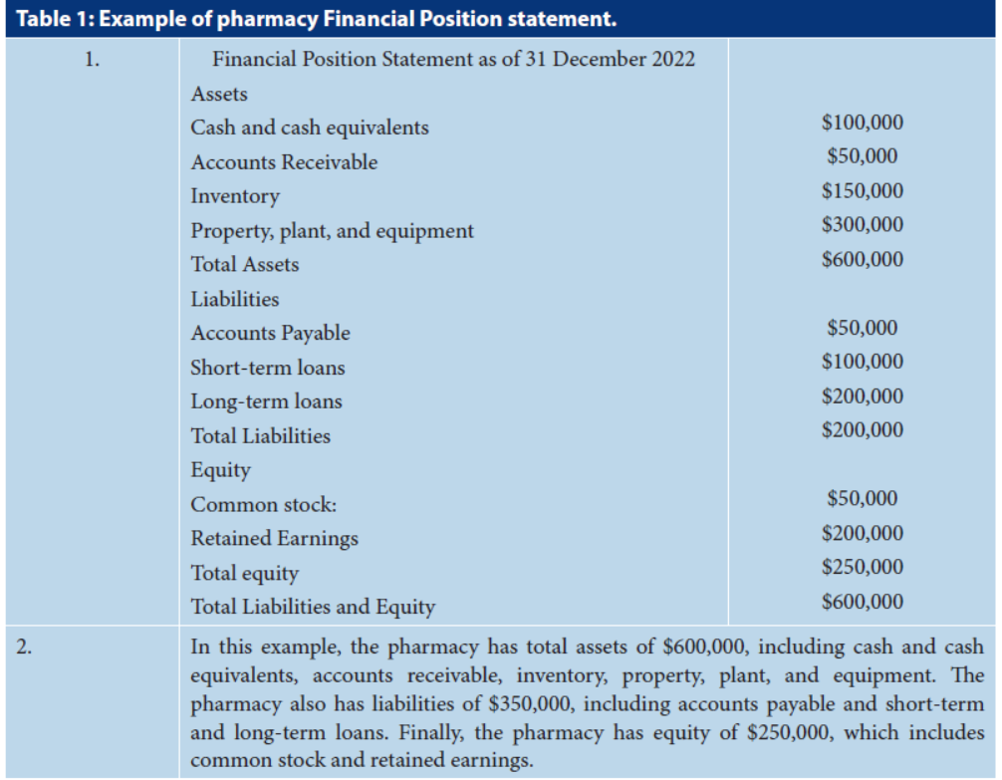

Slide 6
CONCLUSION:
The Financial Management Report in Pharmacy Business Policies and Procedures is a new approach to the overall performance of pharmacy accounting and financial systems. A pharmacy operation’s balance sheet consists of assets, liabilities, and equity at a point in time and how these items have changed over time. The financial situation requires various analytical requirements such as general analysis, profitability, liquidity, liabilities, efficiency, price analysis, market analysis, and investment analysis. Particular attention is paid to the fact that the statement of financial position has been introduced into the pharmacy operating policies and procedures in the pharmacy accounting and financial system of Saudi Arabia.

