Slide 1
Basic Knowledge of Physician about Total Parenteral Nutrition in Saudi Arabia
Jawza F. Alsabhan, Yousef Ahmed Alomi, Anwar Tashan Zaid Alanazi, Rashed Abdullah Nasser Almutairi, Abdulmajeed Ali Alshehri

Slide 2
ABSTRACT:
Objectives: To explore the physician’s basic knowledge about Total Parenteral Nutrition in Saudi Arabia. Methods: It analyzes a cross-sectional survey that discussed the physician’s basic knowledge of some items for Total Parenteral Nutrition services (TPNs) in Saudi Arabia. The survey consisted of respondents’ demographic information about the Assessment of Total Parenteral Nutrition services (TPNs) knowledge of physicians, The resources of Parenteral Nutrition services (TPNs) used by physicians. The 5-point Likert response scale system was used with closedended questions. The survey was validated through the revision of expert reviewers and pilot testing. Besides, various tests of the reliability of McDonald’s ω, Cronbach alpha, Gutmann’s λ2, and Gutmann’s λ6 been done with the study. Furthermore, the physician›s basic knowledge about Total Parenteral Nutrition is analyzed through the survey monkey system. Besides, the Statistical Package of Social Sciences (SPSS), Jeffery’s Amazing Statistics Program (JASP), and Microsoft Excel sheet version 16.

Slide 3
ABSTRACT:
Results: A total number of 409 physicians responded to the questionnaire. Of them, almost one-half responded from the Northern region (186 (45.48%)), and one Quarter responded from the central area (106 (25.92%)), with statistically significant differences between the provinces (p=0.000). Females responded more than males (268 (65.53%)) versus 141 (34.47%)), with statistically significant differences between all levels (p=0.001). Most of the responders were in the age group of 36-45 years (198 (48.41%)) and 46-55 years (109 (26.65%)), with statistically significant differences between all age groups (p=0.000). Almost one-half of responders, 176 (43.03%), worked at an organization that had Parenteral Nutrition services (TPNs) services, with only 86 (21.03%) had been ever requested any Parenteral Nutrition services (TPNs) with statistically significant differences between all answers (p=0.000). The average score of basic knowledge of physicians about the Total Parenteral Nutrition services (TPNs) was (2.57). The element “Have you ever heard about the concept of Total Parenteral Nutrition services (TPNs)” obtained the highest score (3.22). The aspect “know the requirements of TPN through peripheral line administration” (2.89). The element “know the interaction of the drug with total Parenteral Nutrition services (TPNs)” was (2.76). The most resources for Parenteral Nutrition services (TPNs) were the Saud Food and Drug Authority (SFDA) website 178 (43.63%), Peer discussions 113 (27.70%), and Medical association literature/guidelines/recommendations 112 (27.45%). Conclusion: financial statement preparation, Closing entries, and Post-closing trial balance. The accounting cycle policy and procedures are a new pharmacy initiative project. The accounting cycle policy and procedures in pharmacy practice provide accurate accounting and Financial Records, Improved Financial Management, Better tax compliance, and Improved Cash Flow Management and Decision Making. Therefore, the accounting cycle policy and procedures in pharmacy practice are highly recommended for pharmacy career professionals in Saudi Arabia.

Slide 4
ABSTRACT:
Conclusion : The basic knowledge of physicians about total parenteral nutrition is inadequate. Therefore, targeting education nutrition support for physicians is highly recommended, and the privilege of prescribing TPN should be reviewed.

Slide 5
Key Words :
Basic,
Knowledge,
Total Parenteral Nutrition,
Physicians,
Saudi Arabia.

Slide 6
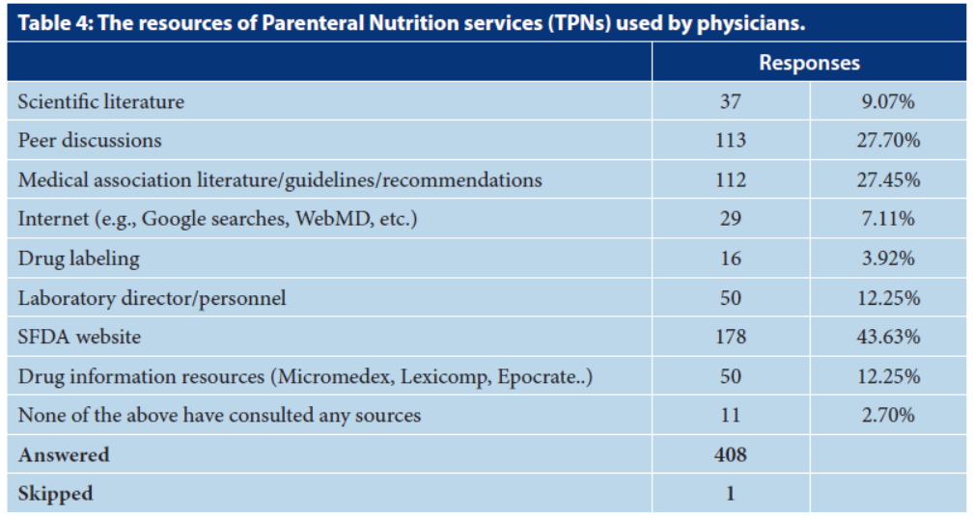

Slide 7
CONCLUSION:
The knowledge of the physician’s profession about parenteral nutrition is insufficient. The physicians are familiar with superficial knowledge such as parenteral nutrition and drug interactions of parenteral feeding. However, the other basic knowledge, including patient assessment for nutrition, enteral feeding, calculation of parenteral nutrition requirements, and TPN complications management, did not reach the optimal level. Although various factors might affect the physician’s knowledge, such as a working site with parental feeding services, female gender, medium experience, and specialist qualifications had higher knowledge of parental nutrition. Besides the presence of TPN at healthcare facilities, the number of patients required for TPN and the number of TPN orders. Therefore, education and training in nutrition support are highly recommended for all general practitioners of physicians in Saudi Arabia.

