Slide 1
Pharmacy Safety and Occupational Health: Crisis and Disaster Management
Yousef Ahmed Alomi, Naif Saleh Alamri, Badriya Mufflih Alrasheedi, Mohannad Ali Abu-Sabah, Abdulah Khalid Al-Otaibi, Mohammed Hakami, Samah Mukhlef Alzaid, Rola AL Kenani, Ammar Ali AlAbdullatif, Areej Abdullah Al Jasser, Ibrahim Ali Al Mughira

Slide 2
ABSTRACT:
Objectives: To the Crisis and Disaster Management policy and procedures in pharmacy practice as a new initiative in Saudi Arabia. Methods: It was a narrative review of pharmacy practice’s Crisis and Disaster Management policy and procedures. Literature searched various databases, including PubMed, Medline, and Google Scholar. The search period is from the 1960s until 06 December 2023. The term is in full-text English and includes Case Reports, Classical Articles, Clinical Conferences, Clinical Studies, Clinical Trials, Evaluation Studies, Government Publications, Guidelines, meta-analyses, Observational Studies, Practice Guidelines, Randomized Controlled Trials, Reviews, Systematic Reviews, with Humans subject. All hospital or community pharmacy services are included in a search term. Besides, the National and international guidelines of general occupational safety and health in hospital practice. The committee of pharmacy accounting policy and procedures formulated and consisted of various expert members. That includes clinical pharmacists, occupational safety specialists, Crisis and Disaster Management, and fire safety experts. The guidelines of the policy draft by one member by the second member were reviewed and corrected. The third revision was by the occupational safety and health specialist. The topic emphasizes the Crisis and Disaster Management of the Pharmacy policy.

Slide 3
ABSTRACT:
Results: Crisis and Disaster Management in pharmacy practice indicates its preparation for an emergency position at a particular time, indicating its assets, competent pharmacy human resources, and related material. The Crisis and Disaster Management consisted of the General concept of crisis and disaster management and the Content of Pharmacy crisis and disaster management (Planning, Implementation, Execution, Training and Education, Exercise and test, Maintenance, and improvement). Conclusion: The Crisis and Disaster Management in pharmacy practice policy and procedures is a new initiative project for pharmacy career professionals. Crisis and disaster management in pharmacy practice improve public demand during healthcare emergencies and risk management decisions. In addition, it encourages pharmacists to participate in public voluntary and charitable activities at various places in healthcare institutions. Therefore, the Crisis and Disaster Management in pharmacy practice policy and procedures policy is highly recommended for implementation in the pharmacy business in Saudi Arabia.

Slide 4
Key Words :
Crisis,
Disaster,
Management,
Safety,
Pharmacy,
Saudi Arabia.

Slide 5
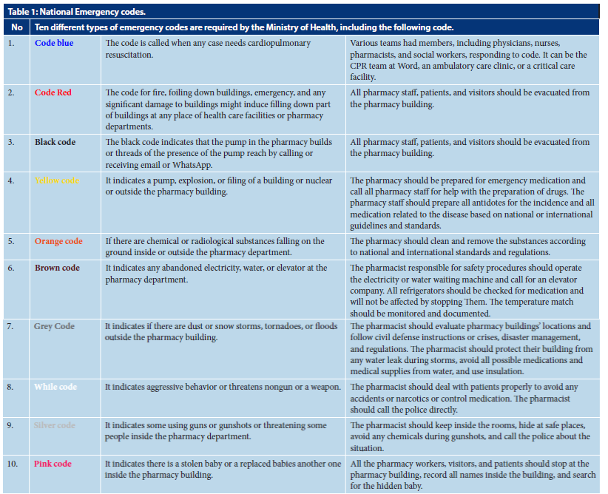

Slide 6
CONCLUSION:
The Crisis and Disaster Management policy and procedures in pharmacy practice are a part of the approach to the overall occupational safety performance of pharmacy systems. General concept for crisis and disaster management, Content of Pharmacy crisis and disaster management (Planning, Implementation, Execution, Training and Education, Exercise and test, Maintenance, and improvement) were essential for pharmacy crises and disaster planning. The pharmacy disaster planning will protect the pharmacy staff and public from any emergency locally or internationally. Particular attention is paid to the fact that pharmacy Crisis and Disaster Management has been introduced into the pharmacy operating policies and procedures in the pharmacy occupational safety and health system of Saudi Arabia.

