Slide 1
Pharmacy Safety and Occupational Health: Education and Training
Yousef Ahmed Alomi, Badriya Mufflih Alrasheedi, Mohannad Ali Abu-sabaa, Naif Saleh Alamri, Abdulah Khalid Al-Otaibi, Mohammed Hakami

Slide 2
ABSTRACT:
Objectives: To explore the occupational safety and health system education and training in pharmacy practice as a new initiative in Saudi Arabia. Methods: It was a narrative review of occupational safety and health policy and procedures in pharmacy practice. Literature searched various databases, including PubMed, Medline, and Google Scholar. The search period is from the 1960s until 06 December 2023. The term is in full-text English and includes Case Reports, Classical Articles, Clinical Conferences, Clinical Studies, Clinical Trials, Evaluation Studies, Government Publications, Guidelines, meta-analyses, Observational Studies, Practice Guidelines, Randomized Controlled Trials, Reviews, Systematic Reviews, with Humans subject. All hospital or community pharmacy services are included in a search term. Besides, the National and international guidelines of occupational safety and health in hospital practice. The committee of pharmacy occupational safety and health policy and procedures formulated and consisted of various expert members. That includes clinical pharmacists, occupational safety specialists, Crisis and Disaster Management, and fire safety experts. The guidelines of the policy draft by one member by the second member were reviewed and corrected. The third revision was by the occupational safety specialists. The topic emphasizes the occupational safety and health system education and training of the Pharmacy policy.

Slide 3
ABSTRACT:
Results: The pharmacy occupational safety and health Education and Training consisted of various items. That has included program objectives, admission requirements, teaching and education methodology, and occupational safety and health Education and Training steps in pharmacy practice. The occupational safety and health education and training contained five models. For instance, Fire safety at pharmacy services, Pharmacy Crisis and Disaster Management, and Pharmacy Material Safety Data Sheet. Besides, the Pharmacy Safety and Occupational Health Surveillance and Monitoring and Quality Management of occupational safety and health. Each model describes the Module description, Learning Objectives, Module Outlines, and Competency items. Conclusion: The occupational safety and health system education and training in pharmacy practice is a new initiative for pharmacy career professionals. It will improve pharmacy occupational safety and health system skills and encourage all pharmacy staff (clinical, distributive pharmacist, and pharmacy technicians) to comply with occupational safety and health system regulations in different pharmacies in various healthcare organizations. Therefore, the occupational safety and health system education and training policy and procedures are required and mandated for pharmacy services in Saudi Arabia.

Slide 4
Key Words :
Occupational safety,
Pharmacy,
Health,
Policy,
Education,
Saudi Arabia.

Slide 5
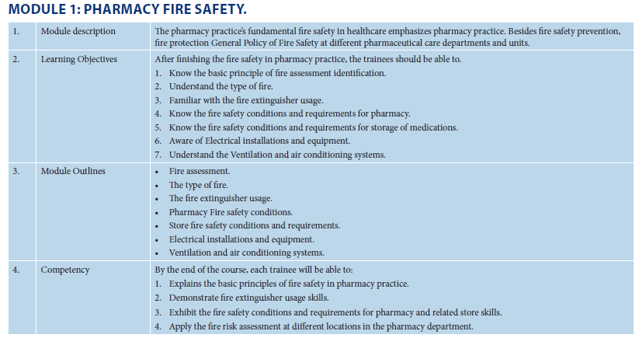

Slide 6
CONCLUSION:
Covering education and training in pharmacy occupational safety and health systems is essential for all levels and types of pharmacy staff, including undergraduate and postgraduate pharmacists. The training program consists of 5 weeks of coaching with five modules: Fire safety at pharmacy services, Pharmacy Crisis and Disaster Management, and Pharmacy Material Safety Data Sheet. Besides, the Pharmacy Safety and Occupational Health Surveillance and Monitoring and Quality Management of occupational safety and health. Each module is explained by understanding the purpose, module outcomes, and competencies. Training and coaching in pharmacy occupational safety and health system coverage and strategy can be carried out efficiently and conveniently at the pharmacy site. The level and methods of training and education in pharmacy occupational safety and health systems have been surprisingly well received in the Saudi pharmaceutical business market.

