Slide 1
Healthcare Professional’s Perception of Pharmacist’s Relationship and Counseling Skills in Saudi Arabia
Yousef Ahmed Alomi, Sarah Abdullah Al-Hathlool, Maryam Ibrahim Almulhim, Amal Ali Alashaq, Yousef Aboshalaf, Mytham Al-Ethan

Slide 2
ABSTRACT:
Purpose: To explore the healthcare provider’s perception of pharmacist’s relationship, communication, and counseling skills in Saudi Arabia.
Methods: This is a 4-month crosssectional survey of the healthcare professional’s perception of the pharmacist. The survey consisted of two parts: first part gathers demographic information and the second part contains 49 questions divided into four domains. (1) the first domain captures data regarding the healthcare provider’s general perception about the pharmacist; (2) the second domain captures data regarding the healthcare professional’s perception of pharmaceutical services; (3) the third domain was regarding the healthcare professional’s perception of visiting ambulatory care; and (4) the fourth domain captures the data regarding the healthcare professional’s perception of pharmacist’s relationship and counseling skills. All healthcare professionals responded to the 5-point Likert response scale system. The survey was distributed through social media to more than 1000 healthcare professionals across the Kingdom of Saudi Arabia. Because the survey was in an electronic format, we were able to analyze and discuss the four domains with respect to the healthcare professional’s perception of pharmacist’s relationship and counseling skills through the Survey Monkey system.

Slide 3
Results: A total of 170 healthcare providers responded to our survey. Of all the responders, 129 (75.9%) were females and 41 (24.1%) were males. Most of the healthcare providers were pharmacists (81 (47.65%)), others (33 (19.41%)), nurses (27 (15.88%)), and physicians (23 (13.53%)). Most of the healthcare providers (143 (87.2%)) spent less than 16 minutes waiting for the medication from the pharmacy. The average score of the healthcare professional’s perception of the pharmacist’s communication and relationship skills was around (3.41). The highest score with respect to the pharmacist’s and patient’s relationship was obtained for the following statements: “The pharmacist politely delivers the medication” (3.96) and “The pharmacist answers questions in an excellent manner” (3.67). The average score of healthcare professional’s perceptions of pharmacists with medication counseling skills was around (3.42). Highest scores were obtained for the following statements: “All the medications received were packed” (4.28) and “The patient understands what the pharmacist was saying” (4.14). The highest score with respect to the patient’s relationship with the drug information center was obtained for the statement: “The pharmacist answers patient’s questions through drug information center of the hospital over 24/7” (3.44) and “Poisonous cases first contact the national drug information center or any other hospital drug information center any time through MOH hotline 937 service over 24/7” (3.37).

Slide 4
Conclusion: The results of this survey revealed that healthcare professionals had an acceptable perception of the pharmacist with respect to communication and patient counseling skills. The healthcare professional’s privacy, easy contact with the pharmacist, and drug-related problems information improve the pharmaceutical services offered to the healthcare professionals in Kingdom of Saudi Arabia.

Slide 5
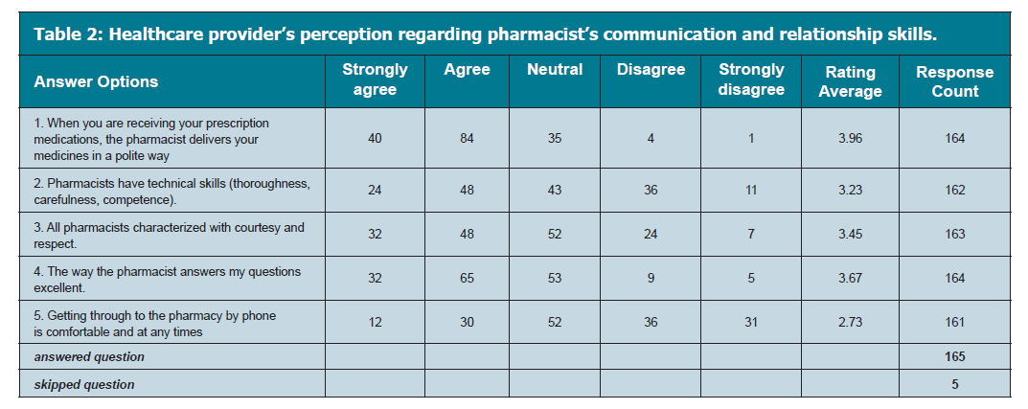

Slide 6
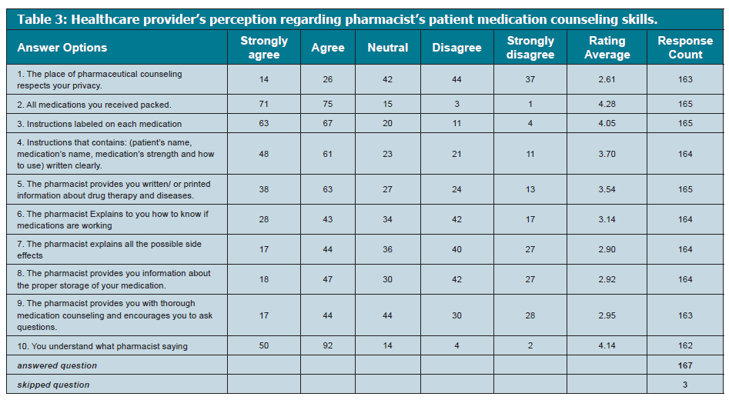

Slide 7
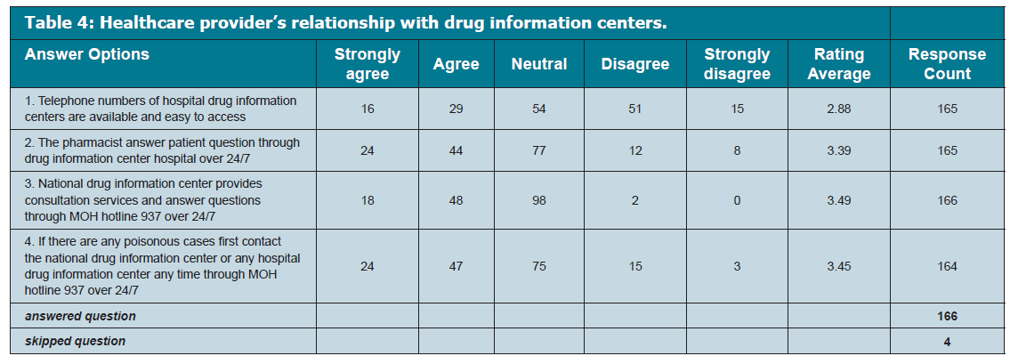

Slide 8
CONCLUSION
The results of this study demonstrate that healthcare professionals had an acceptable perception of the pharmacist with respect to his/her communication and relationship skills and patient medications education. We need to focus on creating a private area and specific instruction about drug-related problems and complications is necessary to all healthcare providers in the Kingdom of Saudi Arabia.

