Slide 1
Patient’s General Perception and Attitude toward Pharmacists in Saudi Arabia
Yousef Ahmed Alomi , Sarah Abdullah Al-Hathlool, Maryam Ibrahim Almulhim, Amal Ali Alashaq, Yousef Aboshalaf, Mytham Al-Ethan

Slide 2
ABSTRACT:
Purpose: To explore the patient’s perception and attitude toward pharmacists in Saudi Arabia.
Methods: This is a 4-month cross-sectional survey of patient perception of pharmacists. The survey consisted of two parts: the first part gathers demographic information and the second part has 49 questions divided into four domains: (1) the first domain captures patient’s general perception of the pharmacist; (2) the second domain is regarding patient’s perception of pharmaceutical care services; (3) the third domain is about patient perception of visiting ambulatory care; and (4) the fourth domain is regarding patient’s perception of pharmacist’s relationship and counseling skills. We used the 5-point Likert response scale system to obtain responses of the participants. There were open- and close-ended questions. The survey was distributed through social media to a 500-bed general hospital in Alhassa region, an ambulatory care pharmacy. The authors interviewed the patients with an electronic survey documentation. The survey analyzed domain one, which is the primary or necessary general perceptions about pharmacists and the data were analyzed through the Survey Monkey system.

Slide 3
Results: A total of 617 patients responded to the survey. Of them, 536 (87.7%) were Saudi and 75 (12.3%) were non-Saudi nationals. There were 457 (74.1%) female and 160 (25.9%) male responders. In the past 12 months, most patients (222 (36.04 %)) visited the pharmacy more than 10 times, followed by 122 (19.81%)) visited the pharmacy at least 5–9 times. Most of the patients (481 (83.5%)) spent less than 11 min with the pharmacist. The statements with highest scores were related to the pharmacist’s perceptions such as pharmacy job is vital in our society (4.63); the pharmacist has a very significant role in preventing medications errors (4.4); the necessity of present pharmacist schools (4.09); and the pharmacist is the first person ask about drugs (4.01). More than 60% of the responders chose pharmacy as the professional specialty or suggest their family members or friend to select a professional pharmacy. The majority of pharmacists shared information in public education through the television and media (3.7) and newspaper (3.65) followed by schools (3.56) and public education exhibitors (3.48). Most of the patients (429 (73.1%)) visited the pharmacist to seek help, and due to the pharmacists knew more about medication doses and their adverse effects (224 (38.16%), and free consultation 166 (28.28%)

Slide 4
Conclusion: Majority of the patients had a good perception about the pharmacist and his role with patients and the public. The pharmacists should expand their services across all healthcare institutions in Saudi Arabia.

Slide 5
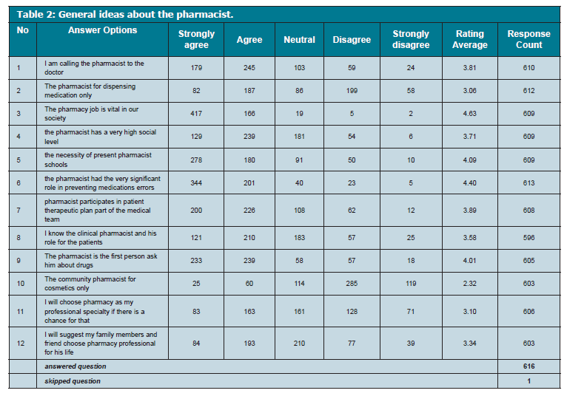

Slide 6
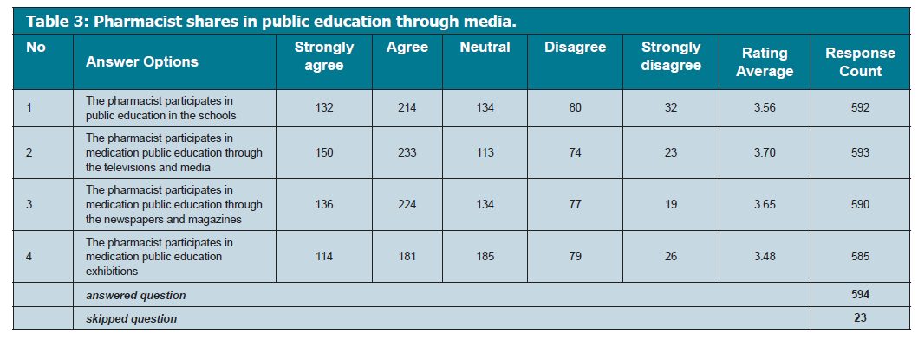

Slide 7
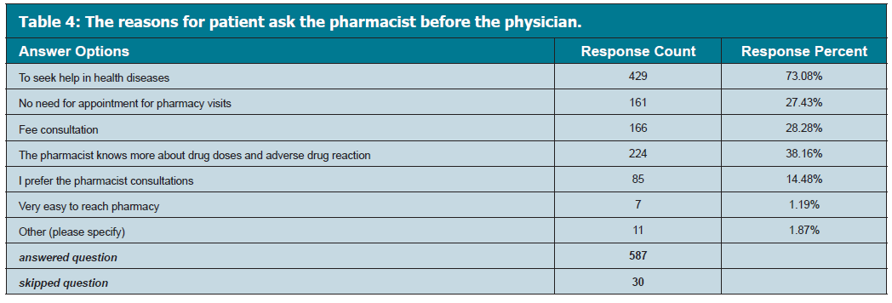

Slide 8
CONCLUSION
The patients showed a good perception of the pharmacy services in the Saudi society. The pharmacy services should be expanded with much involvement of a pharmacist in the therapeutic plan.

