Slide 1
Poisoning Due to Stored Medications at Home in Al-Qassim Region, Saudi Arabia
Afaf Badr Alenazi, Mansour Saleh Alsharidah,
Amal Hassan Al-Najjar, Suliman Abdulaziz Alghazy,
Abdul-Aziz Abdullah Alqadi, Amir Marzouk

Slide 2
ABSTRACT:
Objective: Storing medications at home is a global practice. By storing medications in an appropriate and safe environment, we can prevent accidental poisoning. Information is scarce regarding the storage of different types of medications at homes in Al-Qassim region, Kingdom of Saudi Arabia. Therefore, in this study, we aimed to explore the cases of poisoning due to stored medications at home in Al-Qassim region.
Methodology: This is a descriptive, cross-sectional survey conducted through the random distribution of a pre-validated structured questionnaire among the public and private sector employees and people from all walks of life above the age of 18 years in Al-Qassim region. The survey was designed electronically through the Survey Monkey system and was distributed through social media.

Slide 3
Results: A total of 708 subjects responded to the survey. Most of the responders (485 (68.10%)) were females. About half of the responders were in the age group of 18–29 years (393 (58.31%)) with females being significantly dominant than males (p<0.05). Majority of the responders stored their medications separated from households’ chemicals (524 (77.06%)). Most of the responders did not store multiple medications in the same container without any significant difference related to gender or educational level (p>0.05). The total number of poisonous cases were 41 (5.79%) without any significant difference related to gender or educational level (p>0.05). Poisoning due to medications were mostly caused due to the medications stored in refrigerator (15 (40.54%)) and bedroom (10 (27.03%)). Most of the stored medications were disposed into the trash after their expiry dates (463 (65.4%)) while 189 items remained at home (26.69%). A total of 33 different types of stored medications caused poisoning in 44 cases. Paracetamol caused 6 cases of poisoning (18.18%), followed by ibuprofen 3 (9.09%) and multivitamins 3 (9.09%).

Slide 4
Conclusion: The results of this study revealed an alarming setting of poisoning cases due to stored medications in Al-Qassim region. Awareness campaigns and more educational sessions should be conducted through social media. By doing so, people can be educated regarding the proper storage of medications to prevent poisoning. Thus, public awareness programs stressing on the safe storage and identification of the right ways to dispose of medication are highly recommended.

Slide 5
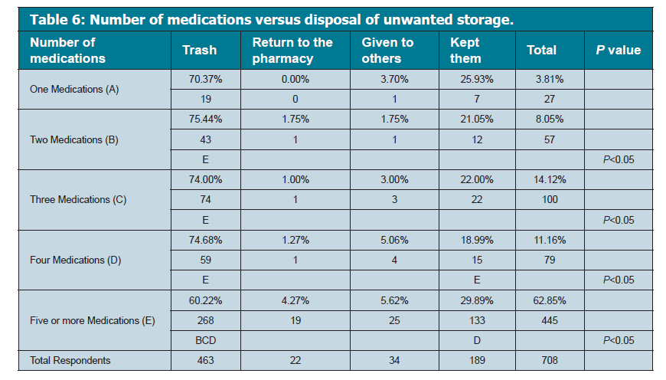

Slide 6
CONCLUSION:
The results of this study point toward the improper methods of storing medications which results in accidental poisoning in Al-Qassim region. Awareness campaigns and more educational sessions should be conducted through social media can be utilized to educate the public regarding the proper methods of storing medications, as well as the need to return the unused medications to the pharmacies if they do not know or have no knowledge on how to dispose the medications in an appropriate method. Pharmacists should collaborate with other healthcare providers in preventing poisoning and conducting the awareness programs stressing on the need for safe storage and identification of the right ways to dispose of unused medications.

