Slide 1
Pharmacist’s Intervention and Medication Errors Prevention at Pediatrics, Obstetrics and Gynecology Hospital in East Province, Saudi Arabia
Amal Ahmad Alanazi, Yousef Ahmed Alomi, Mohammed Mohsen Almaznai, Marzook Aldwihi,Ibrahim Abdul Karim Aloraifi, Fatimah Ali Albusalih

Slide 2
ABSTRACT:
Objectives: Medication errors have a large impact on patient safety and on healthcare cost. Errors occur due to a combination of human and system-related failure. The pharmacist prevents all drug related problems. The objective of this study was to explore pharmacist intervention and prevented medication errors in Pediatrics, Obstetrics and Gynecology at a Tertiary Hospital in East Province, Saudi Arabia. Methods: This article describes 12 months retrospective cohort study of pharmacist intervention and prevented medication errors in year of 2015. This was a retrospective study conducted at 500-bed Pediatrics, Obstetrics and Gynecology in a Tertiary Hospital in East Province, Saudi Arabia. This system was a part of medication safety program. A tertiary hospital had medication safety officer with medication safety committee. All errors or unexpected events related with the medication system or a step in the medication process shall be reported using the medication error from/sheet. The form consisted of patient information, the sources of medication errors and qualification of committing errors. The type of medication errors, description of errors, causes of errors, approval to prevent the errors and the consequence of medication errors by using National Coordinating Council for Medication Error Reporting and Prevention (NCCMERP) system.

Slide 3
ABSTRACT:
Results: The total number of prevented medication errors were 1654 within 827 patients’ prescriptions. The medication errors had been made by physicians followed by nurses. The sources of errors were general practitioner 631 (38.15 %) followed by consultant 554 (33.5%). The most common error was made in Pediatrics (1-month to 6 years) followed by young adults (18-40 years). An occurred error, most of the time was afternoon 872 (52.72%) errors followed by morning duty 685 (41.4%) errors. The majority kind of mistakes were prescriber-related 1216 (73.52%) followed by patient-related errors 426 (25.75%). The outcome of medication error was 1651 (99.82%) occurred which did not reach the patient. The most common medications involved in errors were Paracetamol syrup, iron tablet, folic acid tablet and calcium tablet. There were three errors for high-risk medication prohibited for instant: insulin, enoxaparin and heparin. Conclusion: This article presented the pharmacist’s role in preventing medication errors, especially with pediatrics populations. Pharmacists have a crucial system-level role in planning and important medication safety programs and enhancement initiatives within health care organizations. The expanded role of pharmacists in preventing medication errors associated with patient safety programs and avoid the needless cost.

Slide 4
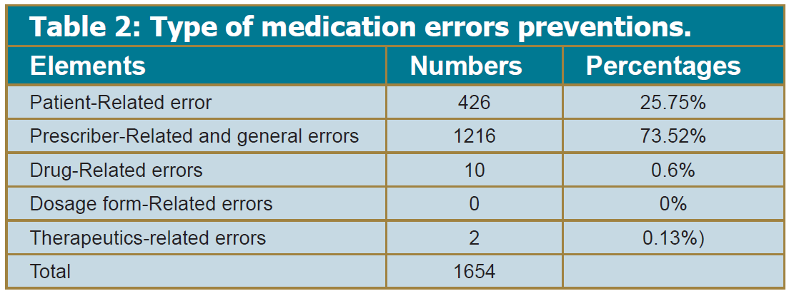

Slide 5
CONCLUSION:
Pediatric medication errors can be reduced through multiple interventions aimed at improving the medication process. Further research is needed in the areas of ambulatory patients, non-developed countries, administering and dispensing errors and community hospitals and should use identical definitions for medication errors and outcomes. Basic medication safety course is essential for all pediatrician working at healthcare institutions. Additional cost-effectiveness data on interventions and preventions to diminish pediatric medication errors would advantage policy makers and medical leaders as they choose between multiple possible interventions. Reducing medication errors offerings an important occasion for refining the quality and variety of current research. Expanding of pediatrics medication safety program is highly recommended at hospitals in Kingdom of Saudi Arabia.

