Slide 1
Primary Healthcare Centers Pharmacy Technician Workforce over Twelve Years (2006-2017) in Saudi Arabia
Yousef Ahmed Alomi, Saeed Jamaan Alghamdi,
Radi Abdullah Alattyh

Slide 2
ABSTRACT:
Objectives: To explore the workforce of pharmacy technician at MOH Primary Healthcare Centers over the past twelve years (2006-2017) in the kingdom of Saudi Arabia. Methods: It is a retrospective analysis of twelve years (2006-2017) of Ministry of Health pharmacy technician workforce at Primary Healthcare Centers (PHCs) practice. All data derived from Ministry of Health Statistical Year Books and any missing appropriate information about pharmacy technician workforce, that’s will be estimated through allied healthcare professional’s data at each region including gender or nationality. It included pharmacy technician and exclude all types of pharmacists or clinical pharmacist’s workforces at MOH PHCs setting. All calculations were based on MOH workforce standards of Primary Healthcare Centers. All calculation was done using Microsoft Excel version ten.

Slide 3
ABSTRACT:
Results: The total numbers of pharmacy Technician were 8.373 and who distributed at the hospital were 6,620 (79.06%), at primary care centers 1,623(19.38 %) while administration regions 130 (1.55%). The total number of pharmacy technician was (1,623) with rage (891-1,623 and average (1,292). While the average numbers per region of PHCs pharmacy technician were (65) with a range number of (32-84). The average numbers of pharmacy technician per pharmacist per region (9.11) with a range number of (0.83-14.83) annually. The estimated average rage gender distribution of PHCs pharmacy Technician per region were male (31-72) with average 56 (86.15%), while the female was (6-12) and average 9 (13.84%). The estimated average rage nationality distribution of PHCs pharmacy Technician per region was Saudi (30-80) with average 61 (93.84%), while the non-Saudi was (1-13) and average 4 (6.16%). Conclusion: One fifth of the pharmacy technician worked at the Ministry of Health PHCs. The majority of pharmacy technician was Saudi and the male gender. The ratio of pharmacy technician was very high related shortage of pharmacists. The analysis of pharmacy technician workforces at PHCs is highly recommended annually in Saudi Arabia.

Slide 4
Key Words :
Primary Healthcare Center,
Pharmacy technician,
Workforce,
Ministry of Health,
Saudi Arabia.

Slide 5
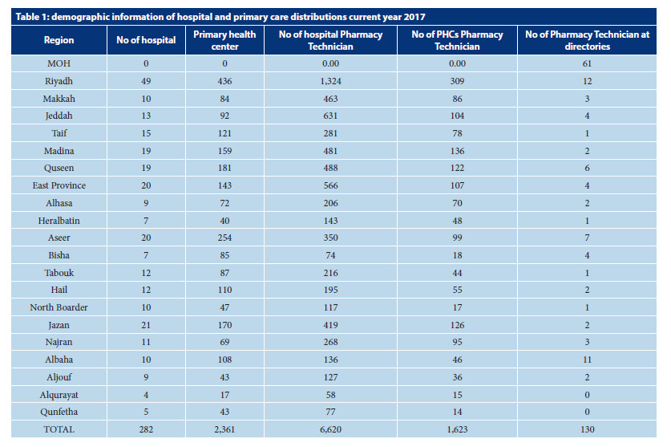

Slide 6
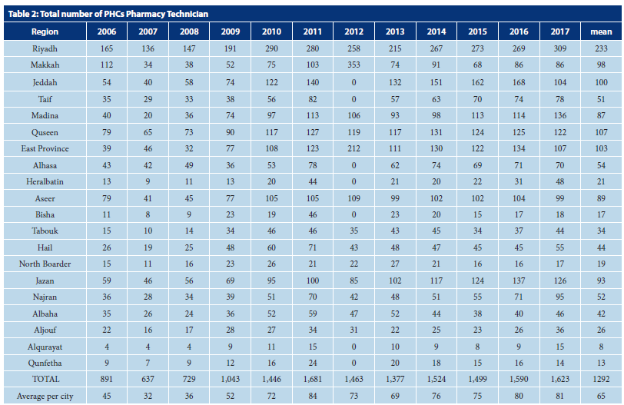

Slide 7
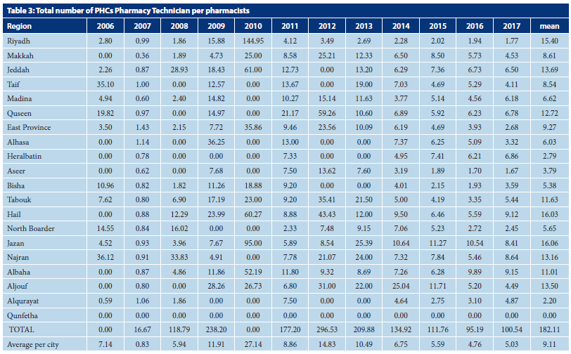

Slide 8
CONCLUSION:
The study was first study done in Saudi Arabia and Gulf and Middle East countries. The majority workforces of Ministry of Health primary healthcare centers pharmacy technicians were Saudi nationally and male was higher than female gender. The pharmacy technician to pharmacist ration was highly related to shortage of pharmacist. The annual report of PHCs pharmacy technician at all healthcare organizations is required in the kingdom of Saudi Arabia.

