Slide 1
Cost Analysis of Clinical Compounding in Saudi Arabia: Antibiotic Pediatrics Formulations
Yousef Ahmed Alomi, Malika Alhadab, Faiz Bahadig,
Mohammad Jabir Al Harbi, Mona Lubbad,
Ebtesam Nazal

Slide 2
ABSTRACT:
Objective: The aim of this study to explore the cost analysis of selected pediatrics antibiotics formularies in the Kingdom of Saudi Arabia. Methods: It is a retrospective cost analysis of pediatrics formulations at 300-beds pediatrics and maternity hospital in Riyadh city, Saudi Arabia. The pharmacy section received the specific formulation from physician then the expert pharmacist applied the international standard of clinical compounding through providing to healthcare staff over eight hours per days for five days per a week. The pediatrics formulations consisted of selected four antibiotics (Nitrofurantoin, Oseltamivir, Chloroquine and Clindamycin). The analysis of the cost included the variable expenses included personal cost, material and supply cost, Costs fixed including direct cost, non-salary cost and overhead cost. The cost was derived from the Ministry of Health information database. All cost used US dollar currency. The study analyzed the cost of anti-hypertension pediatrics formulations through the Microsoft Excel sheet version 10th.

Slide 3
ABSTRACT:
Results: The estimated average total standard cost of pediatrics formulations per hour was (53.82 USD). The average estimated cost of Nitrofurantoin per each preparation was (14.13 USD) which consisted of standard cost (0.31 USD) and the direct cost was (13.82 USD). The average estimated cost of Oseltamivir per each preparation was (16.95 USD) which consisted of standard cost (0.33 USD) and the direct cost was (16.62 USD). The average estimated cost of Chloroquine per each preparation was (6.645 USD) which consisted of standard cost (4.36 USD) and the direct cost was (6.645 USD). The average estimated cost of Clindamycin per each preparation was (14.478 USD) which consisted of standard cost (2.018 USD) and the direct cost was (12.46 USD). Conclusion: There are varieties in the cost analysis between selected pediatric formulation and manufactured ready-made products. The pharmacist should select the cheapest one among them. The cost analysis of pediatrics formulation was used for health insurance coverage and to meet the updated pharmacy strategic plan and Saudi vision 2030 in the Kingdom of Saudi Arabia.

Slide 4
Key Words :
Cost,
Clinical,
Compounding,
Antibiotic,
Pediatrics,
Formulations,
Ministry of Health,
Saudi Arabia.

Slide 5
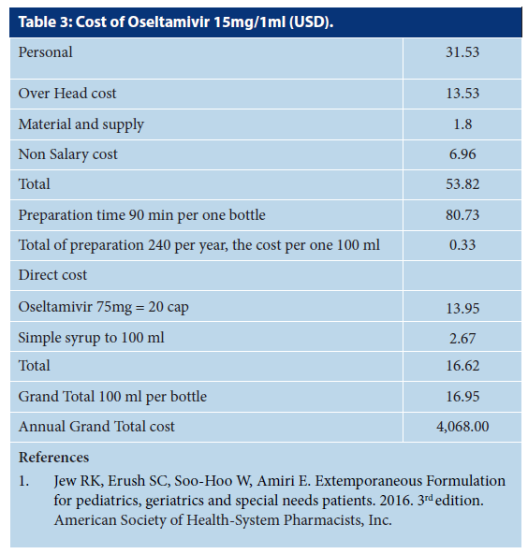

Slide 6
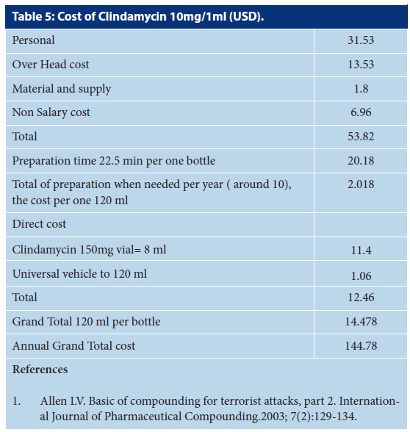

Slide 7
CONCLUSION:
The antibiotics commonly prescribed for adults and pediatrics in over the world. Antibiotics adults’ oral dosage form is mostly available in the local or international market. However, antibiotics oral pediatrics formulation is available for most used medications except orphan drugs or not commonly used for neonates or pediatrics. Besides, the cost of antibiotics oral pediatric formulation is unknown. The cost analysis of the orphan drug is a crucial element of the pharmacy budget. The determination of cost analysis of antibiotics orphan medications is highly recommended regularly in the kingdom of Saudi Arabia.

