Slide 1
National Survey of Pharmacy and Therapeutic Committees in Saudi Arabia: Scope, Structure and Responsibilities
Yousef Ahmed Alomi, Sultan Mohammed Al-Jarallah, Rasha Abdelsalam Elshenawy, Faiz A. Bahadig Rph

Slide 2
ABSTRACT:
Objectives: The Pharmacy and Therapeutics (PTC) committee, sometimes aptly named the Formulary Committee. PTC is charged with determining the hospital formulary, decisions are made about the inclusion or exclusion of new pharmacotherapeutic and diagnostic agents for inpatients and outpatients. This committee is typically composed of a multidisciplinary team of pharmacy, physician, nursing and hospital clinical and administrative leadership. The aim of the study was to explore the Therapeutic Committee at MOH hospitals in Saudi Arabia: scope, structure and responsibilities. Methods: It is a 4-month cross-sectional survey of National Survey of Pharmacy and Therapeutic Committee at MOH hospitals in Saudi Arabia. The survey consisted of 93 questions divided in two parts: the first part collects the demographic information, the second part contains questions on 4 domains: (1) scope, structure and responsibilities, that is including questions about the pharmacy and therapeutic committee membership, clear mission, vision and values of the pharmacy and therapeutic committee, the responsibilities of the PTC committee and the Sub-committees of Pharmacy and Therapeutic Committee, (2) formulary management system, (3) evaluation of drug formulary and decision-making, (4) committee meetings organization and management. The survey was distributed to the fifty-drug information centers at Ministry of Health hospitals. The survey was in an electronic format with analyzed scope, structure and responsibilities through the survey monkey system.

Slide 3
ABSTRACT:
Results: The total number responders were fifty drug information centers. Of those, 48 (96%) was Saudi and 2 (4%) was non-Saudi. There were 16 (32%) females and 34 (68%) were males. Most of the PTC committee members consisted of a chief of pharmacy department 45 (90%), medical director 41 (82%), physician medical 40 (80%) and head of drug information center 32 (64%). The highest score statements related to committee were the functions of PTC (3.78), objectives (3.61), mission (3.57), with least one was a vision (3.56) and values (3.5). The most responsibility scoring statement was distributed the addition and deletion (4.08), all the departments receive the copy of the revised formulary (4.04), drug evaluation and selection for the hospital was (3.9), drug policy development was (3.9), while the lowest scores were Holds educational programs within the hospital (3.25) and drug monitoring system was (3.57). Most of the subcommittee existed antibiotic committee 38 (76%), medication safety committee 38 (76%), followed by drug utilization committee 9 (18%) and therapeutic guidelines committee 9 (18%). Conclusion: One-third of hospital missed drug information center pharmacist as the member of PTC committee and the pharmacy qualifications of committee members need to improve. Update the committee system and close monitoring required for all MOH hospitals in Saudi Arabia.

Slide 4
Key Words :
National,
Ministry of Health,
Saudi Arabia,
Scope,
Structure,
Responsibilities.

Slide 5
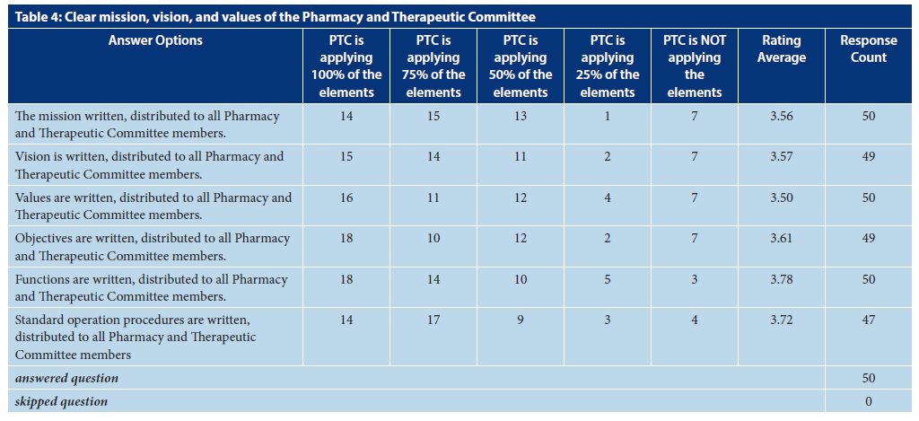

Slide 7
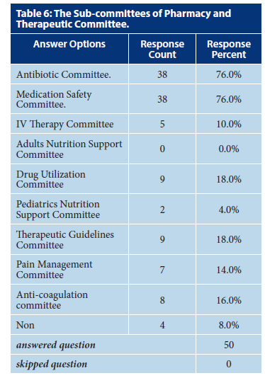

Slide 8
CONCLUSION:
The scopes and functions of PTC at MOH hospitals are not adequately implemented. The PTC membership regulation is old and should be updated. The subcommittees of PTC were few and should expand in quantity and quality manner. Targeting of education and training of PTC members is required with an annual survey of PTC scopes and responsibilities is highly recommended in the Kingdom of Saudi Arabia.

